Slide 1




Tracking Water in the Desert
Tiffany Le
The University of Arizona
Dana Lapides, PhD
USDA ARS, Southwest Watershed Research Center
Arizona NASA Space Grant Consortium Statewide Student Research Symposium
April 18, 2026

Slide 2
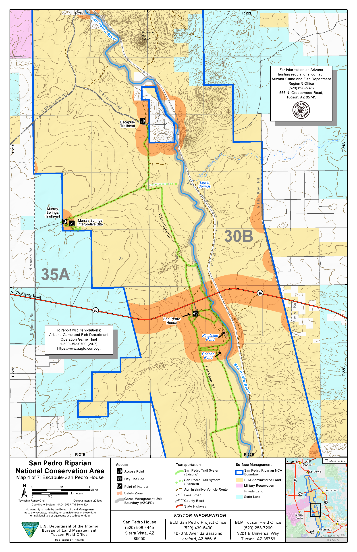
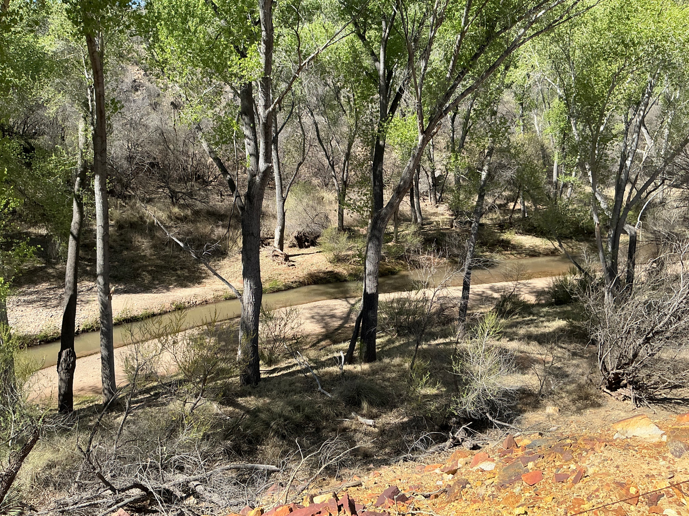
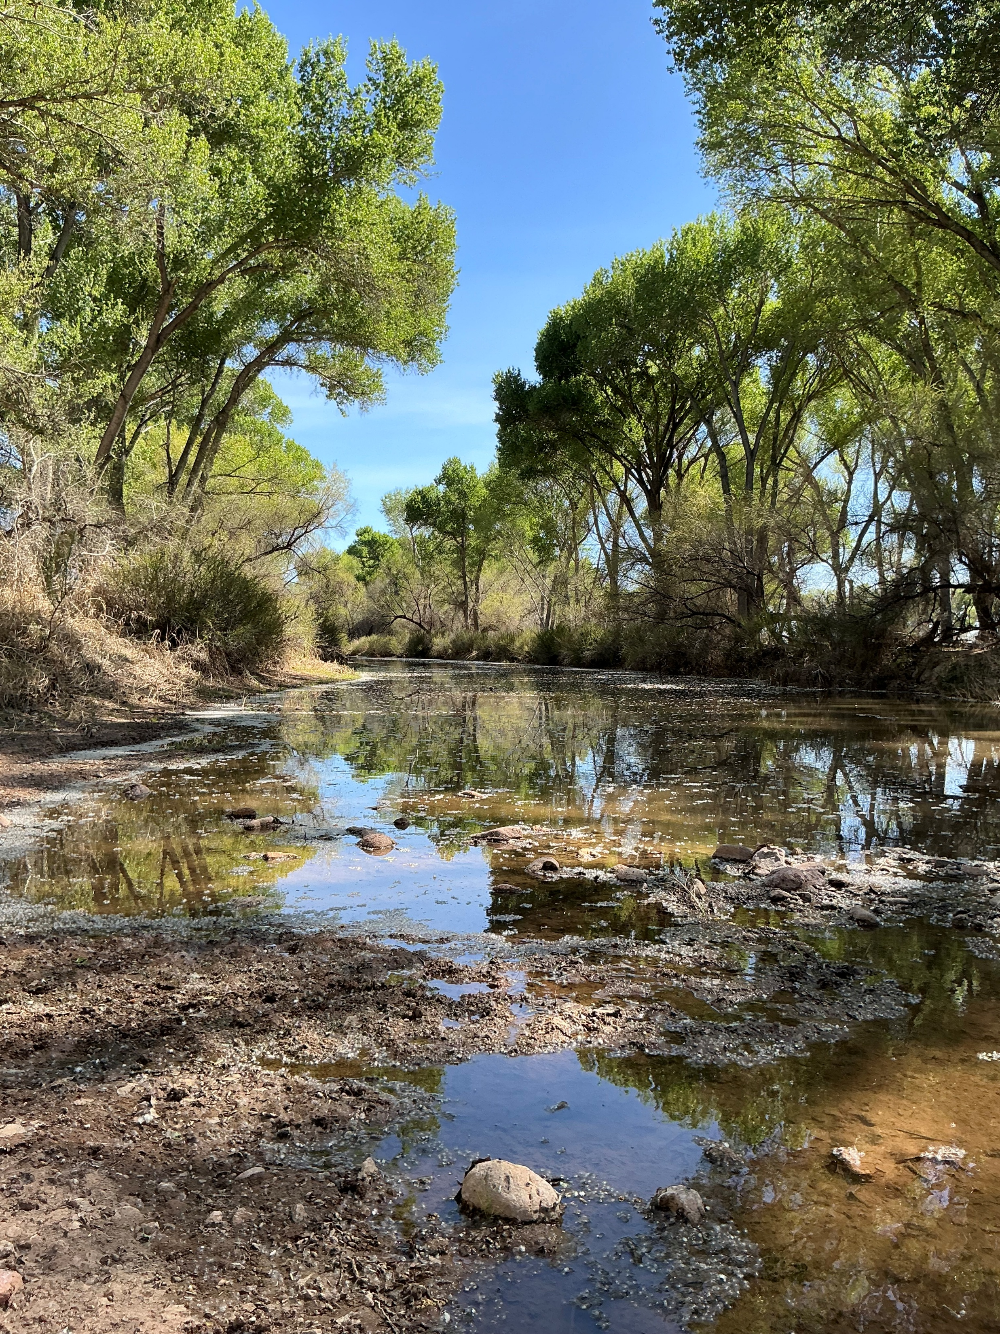
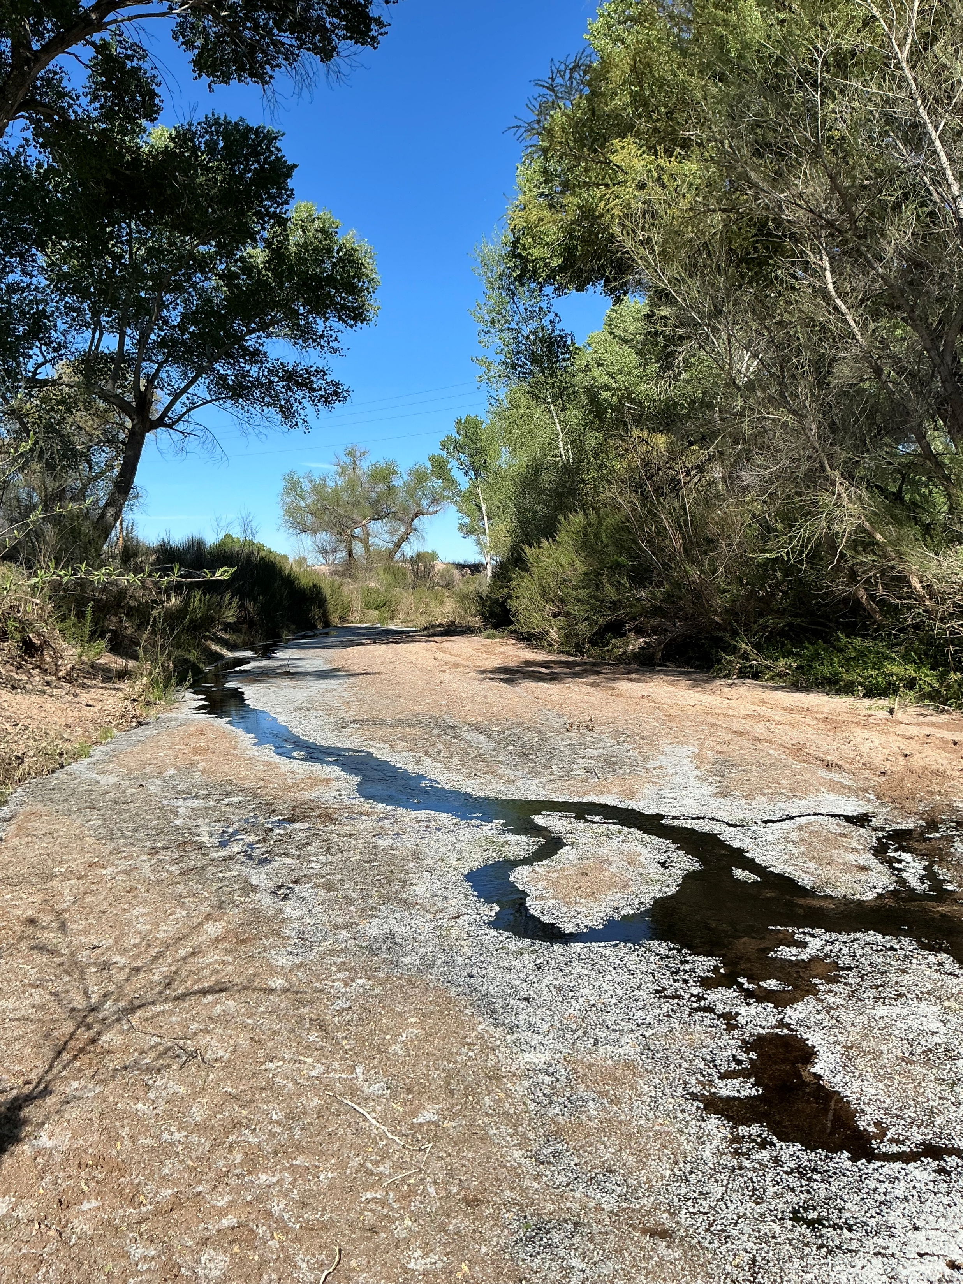
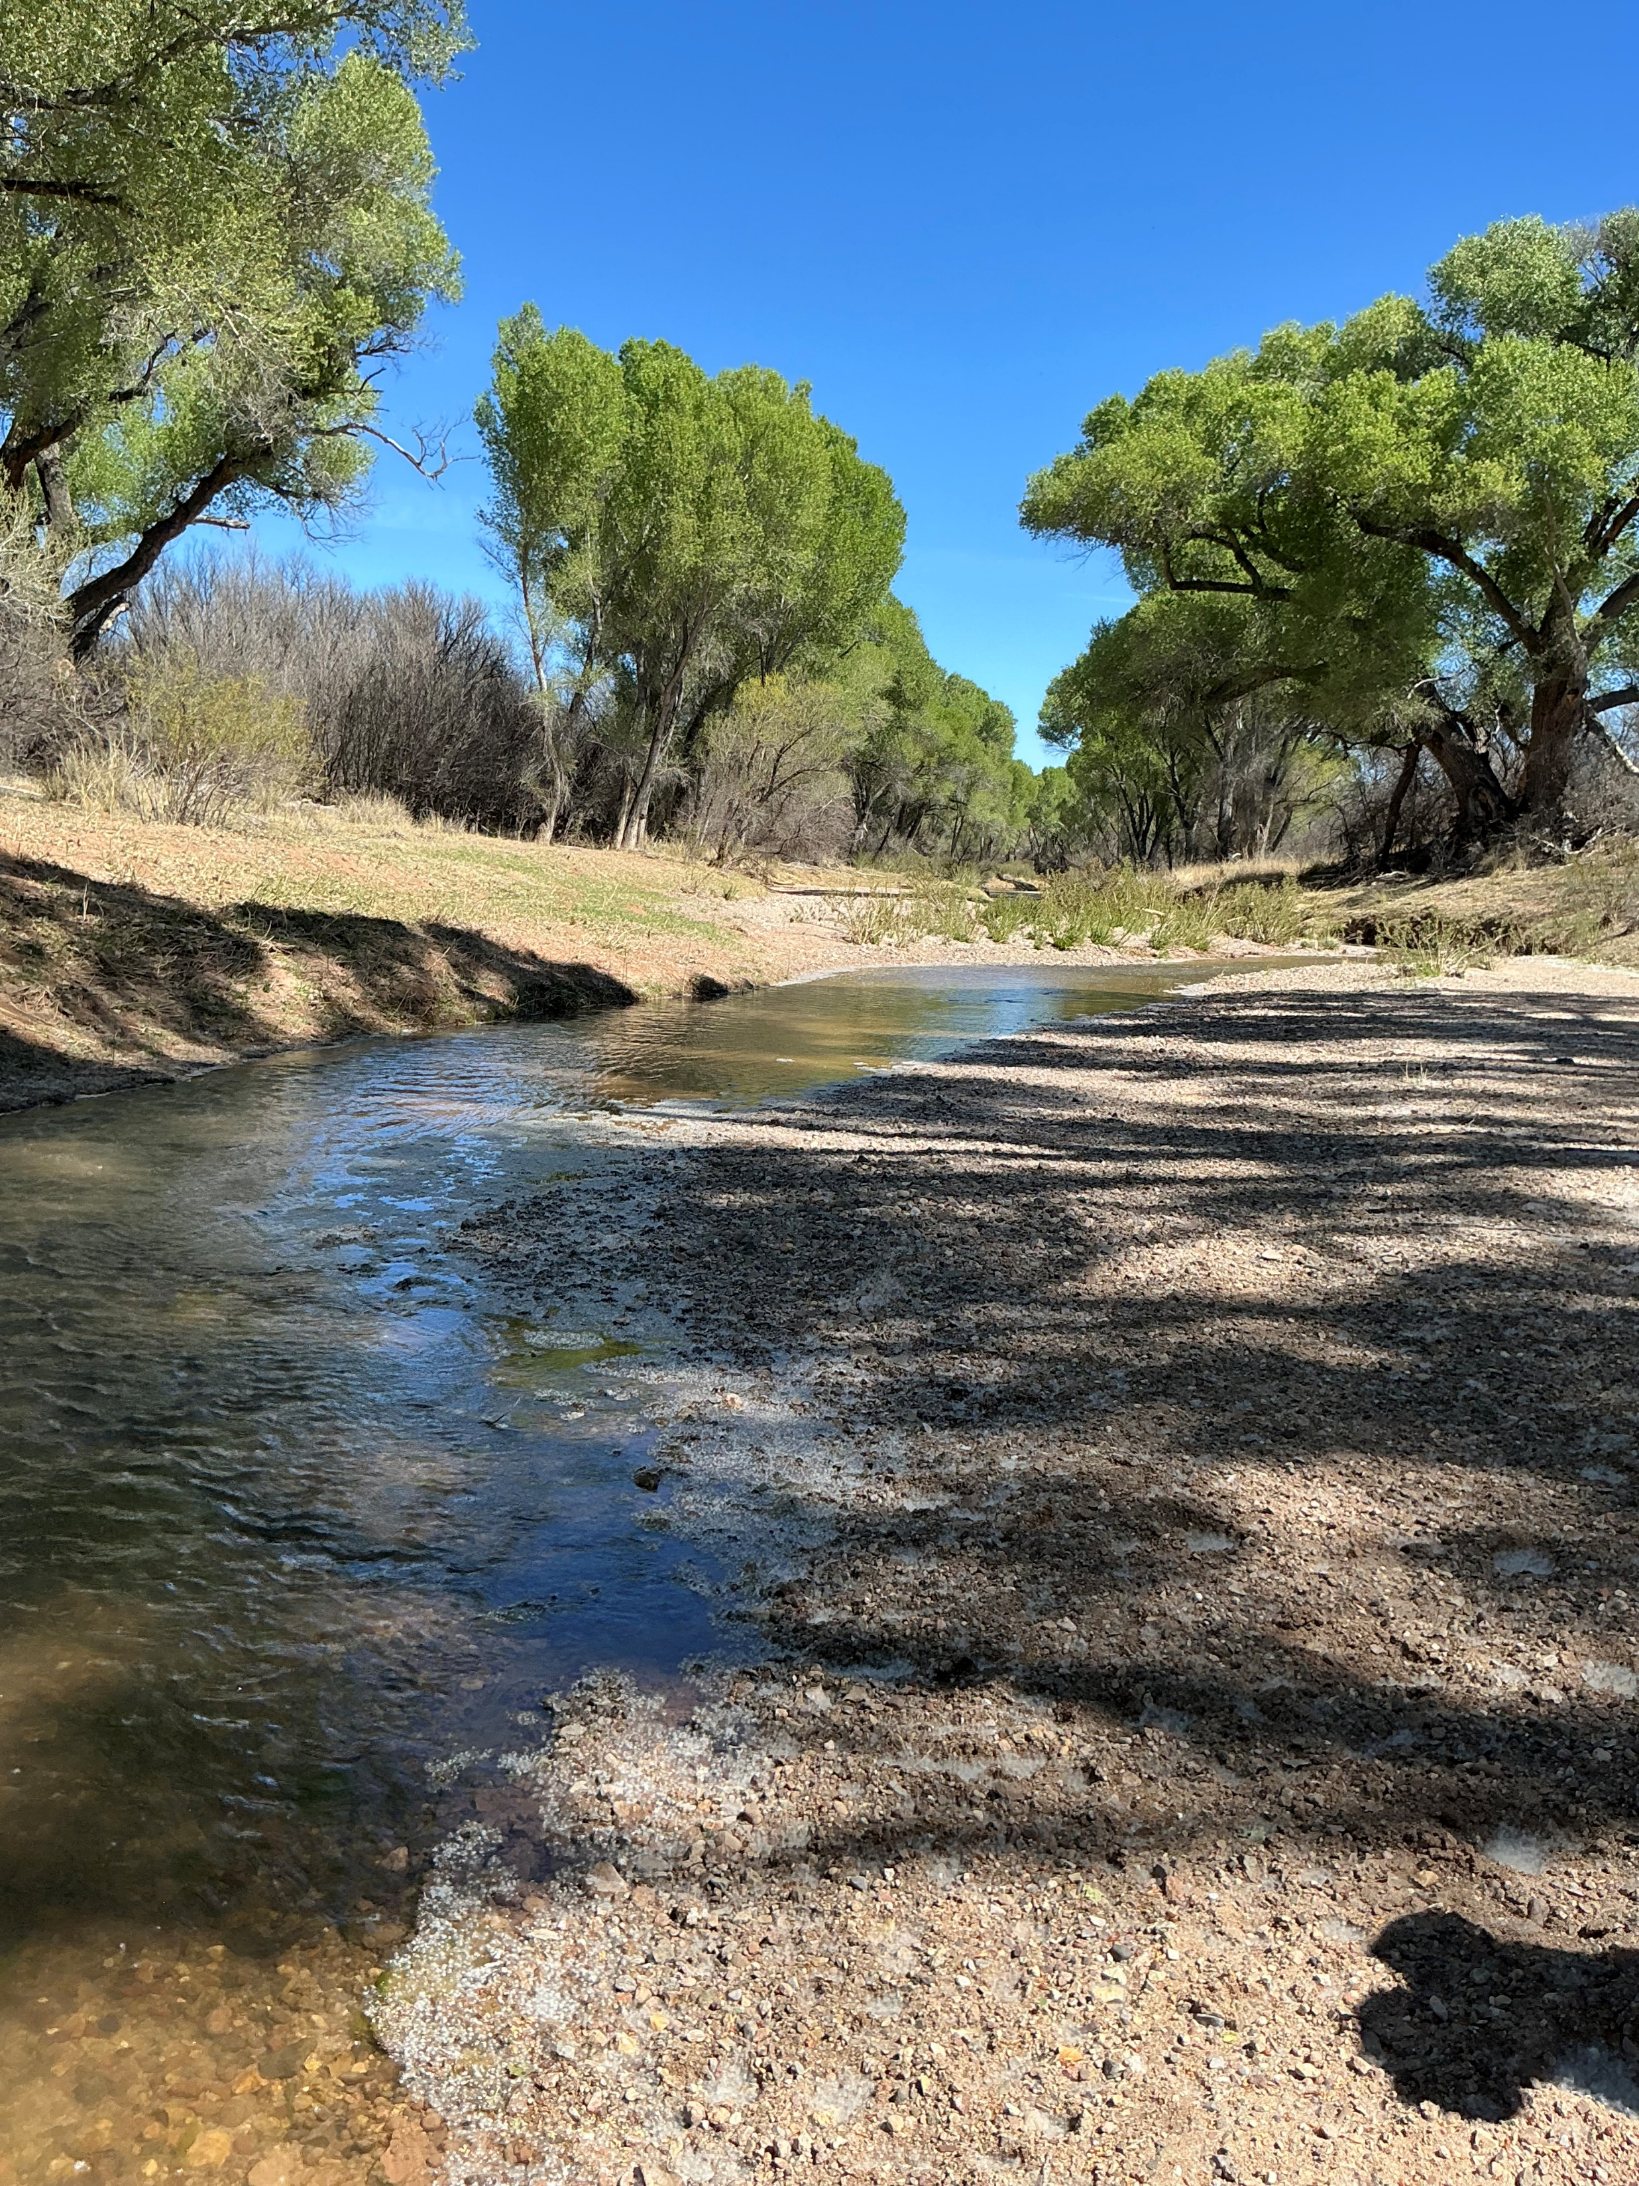
San Pedro River
Largest undammed river in Southwest
San Pedro River National Conservation Area (SPRNCA) established in 1998
  Still disputes over federal water rights
  Streamflow dynamics not well understood in region

Slide 3
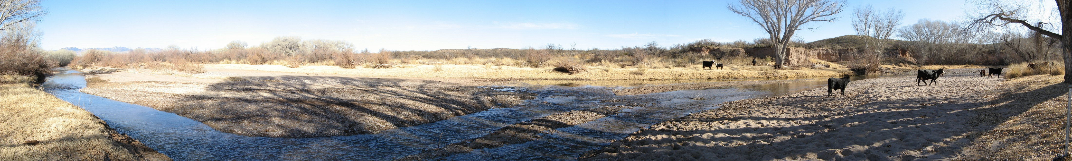
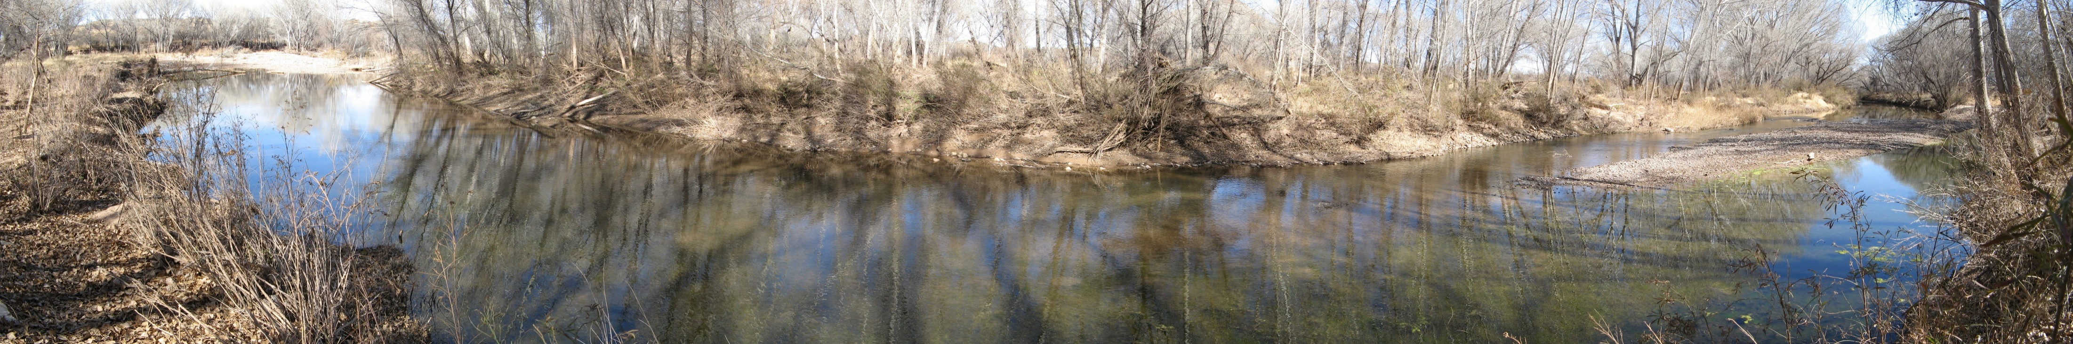
Stream Intermittency
Diagnostic indicator of watershed health
May be used to evaluate if SPRNCA water rights are being met

Slide 4
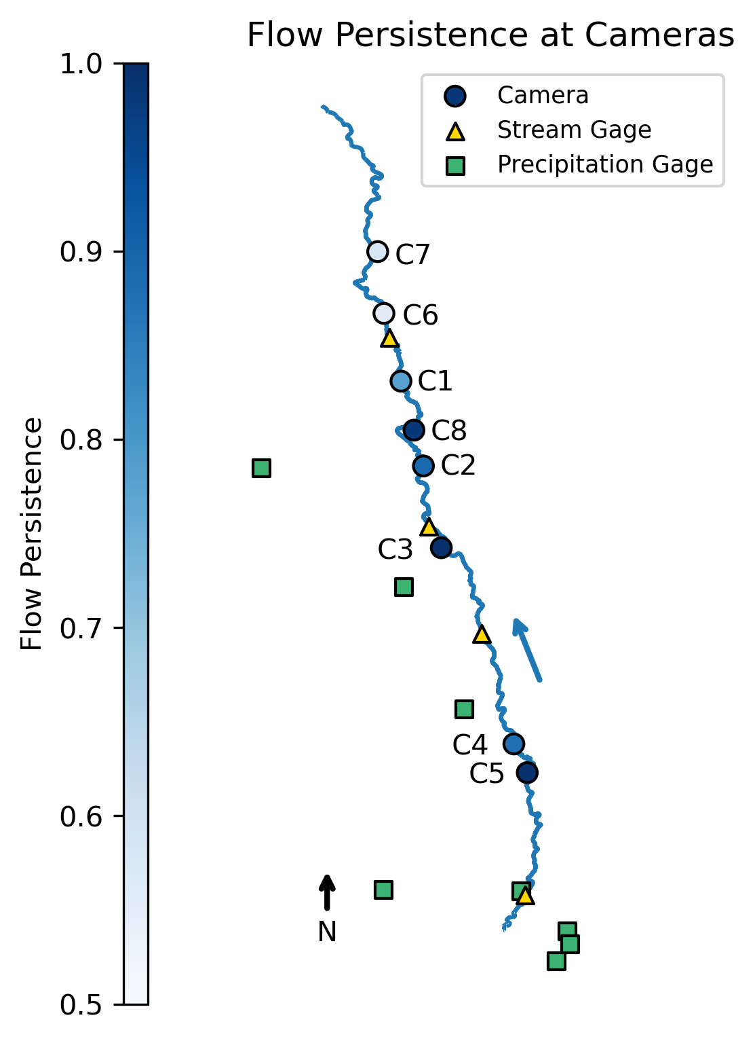
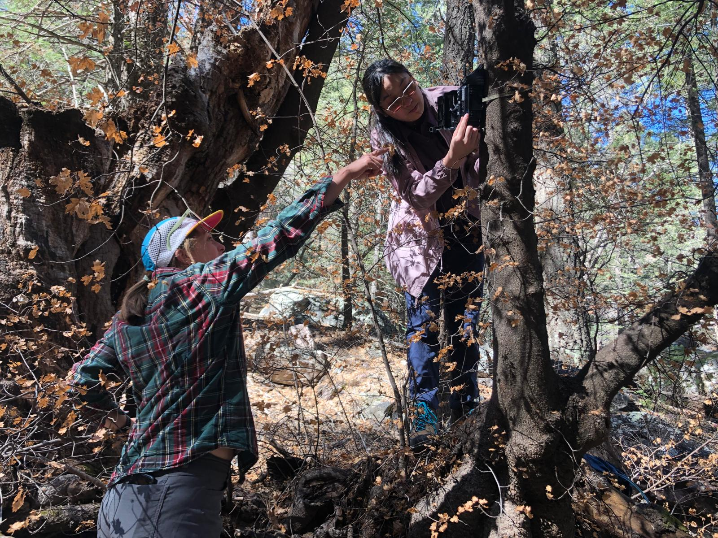
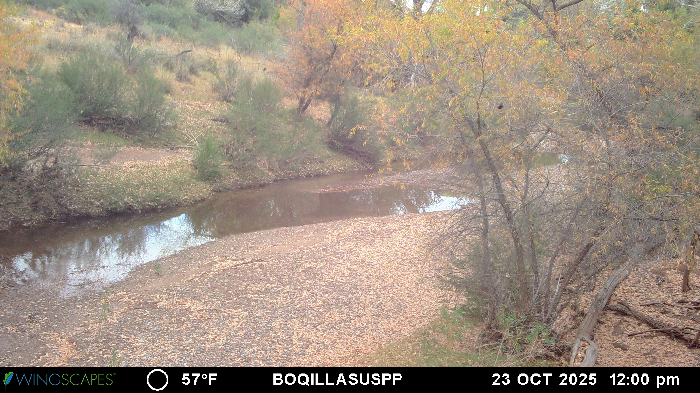
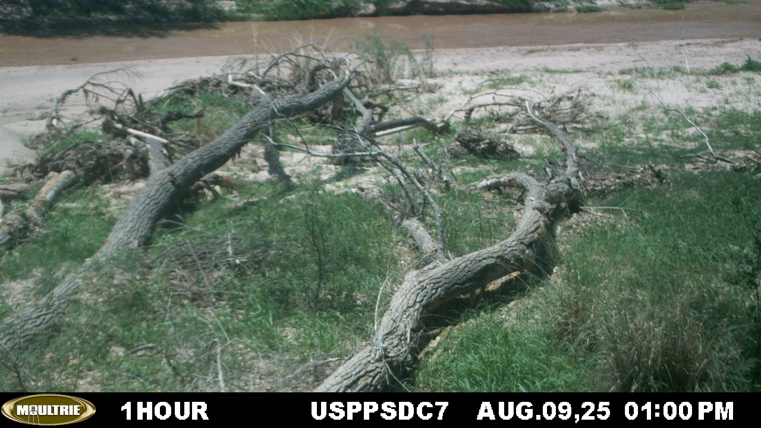
Is the San Pedro River getting drier?
Deployed 14 cameras along stream to capture daily dry/wet/flowing data
Twenty years of data from 8 cameras
Flow Direction

Slide 5
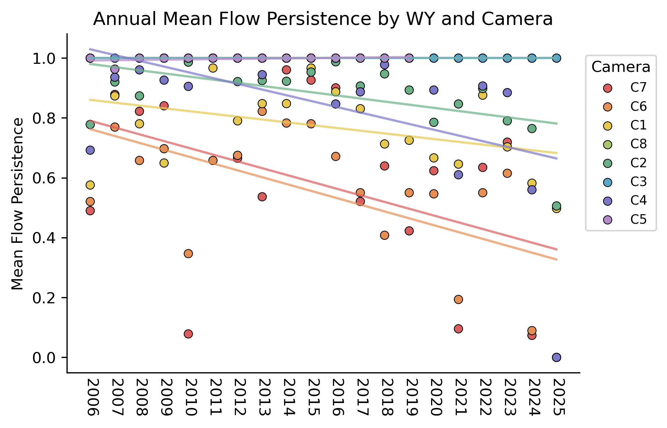
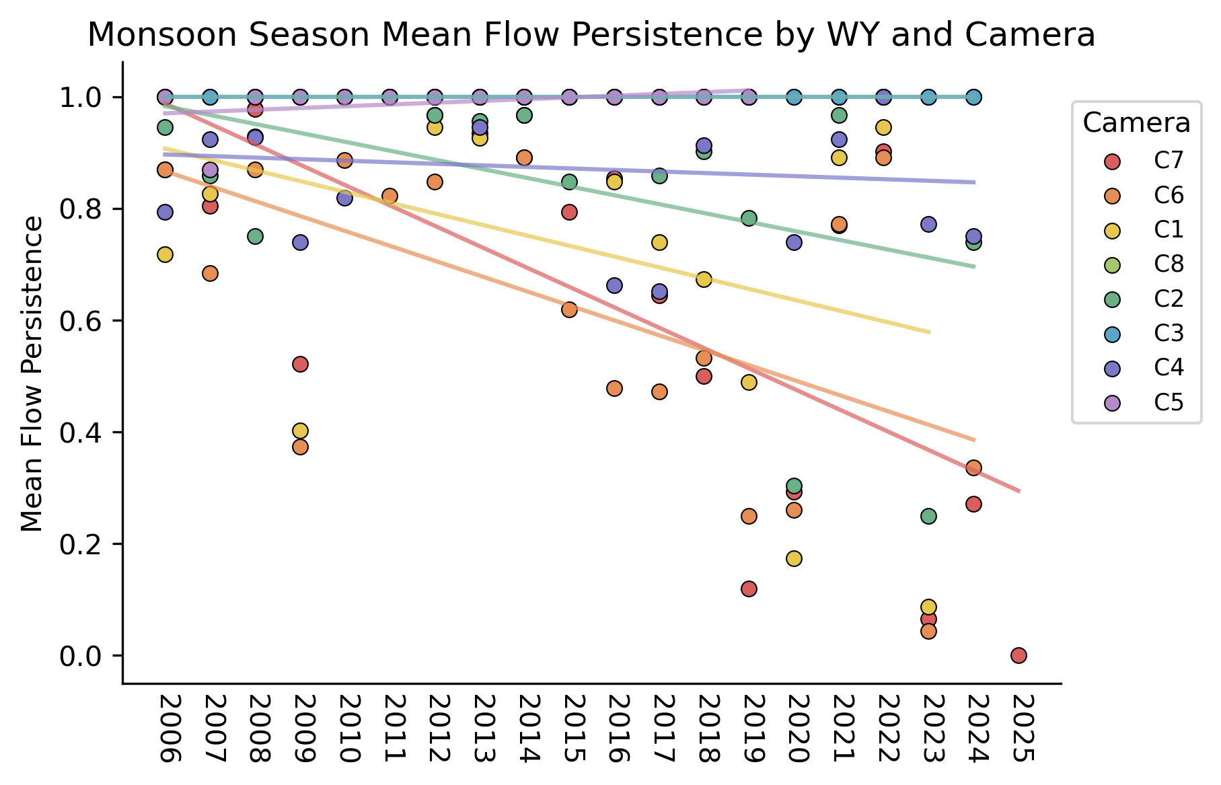
Trends
Flow persistence decreasing annually
Trend most prominent in monsoon season

Slide 6
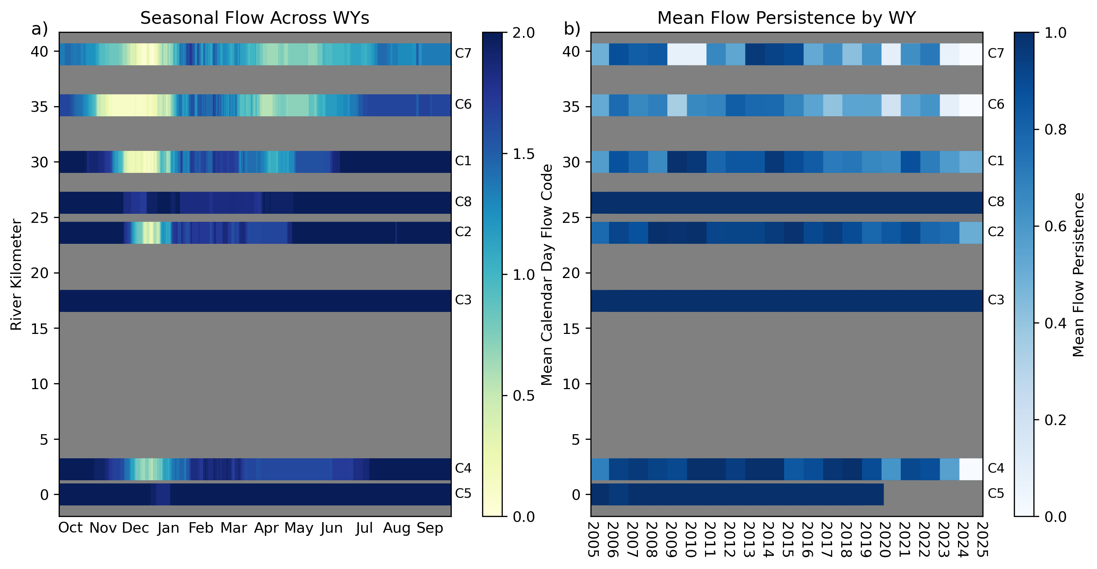
Trends
December driest month
Drier

Slide 7
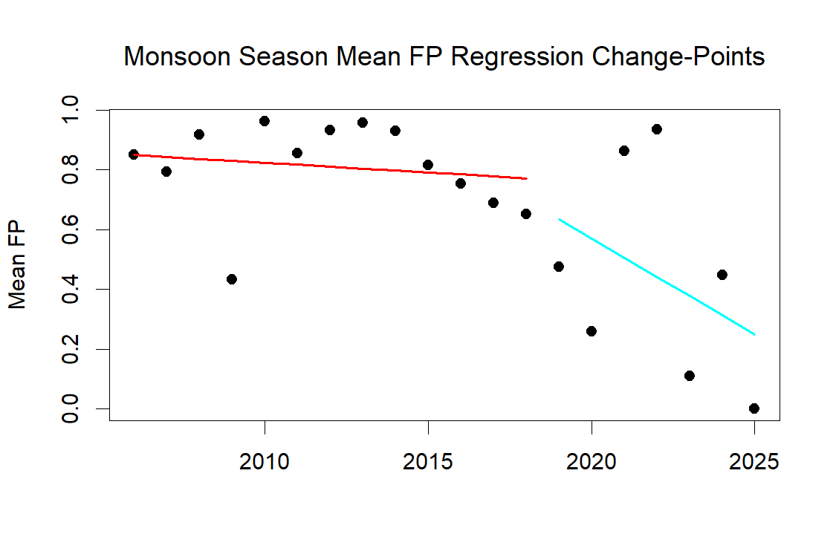
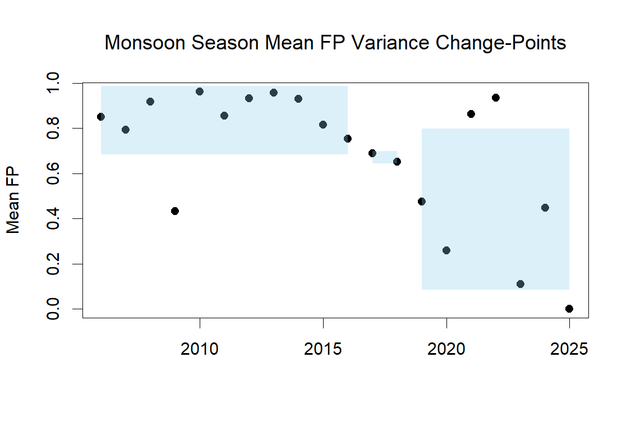
When does surface water presence start declining?
Change-Point Detection (CPD)
  Identifies break points in series where statistical properties change
Shift detected in flow persistence trend and variance in 2018

Slide 8
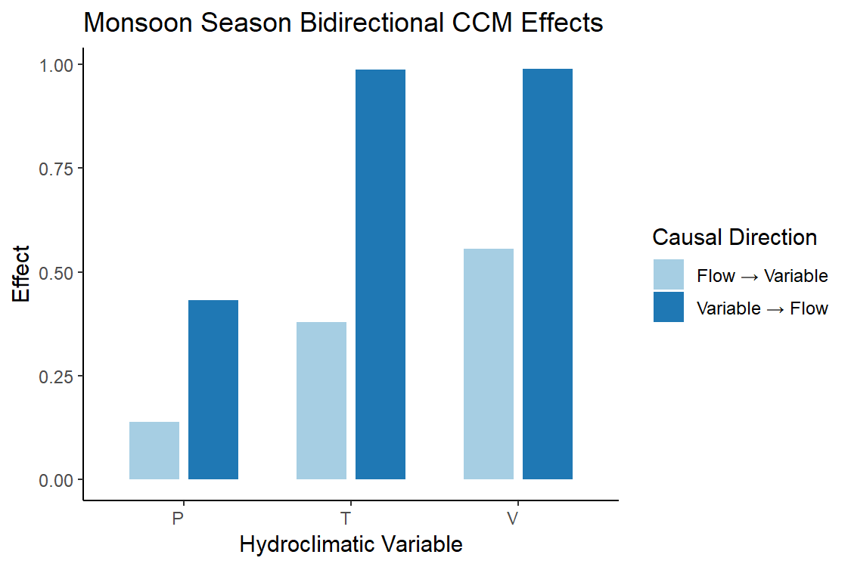
What influences streamflow?
Convergent Cross Mapping (CCM)
  Measures causal influence (0-1)
  Strong effect near 1
Temperature and vapor pressure deficit strongest influence in monsoon season
Precipitation moderate influence
P: Cumulative Precipitation (mm)
T: Temperature (°C)
V: Vapor Pressure Deficit (kPa)

Slide 9
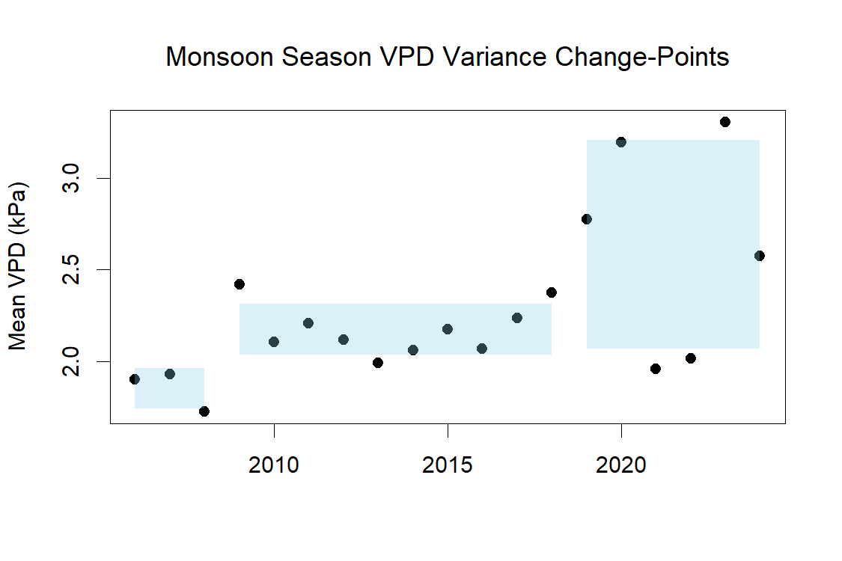
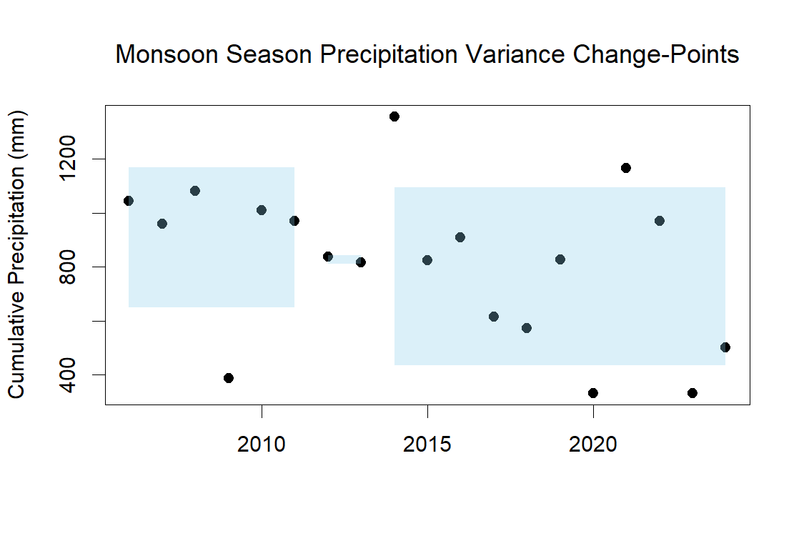
When do they affect surface water presence?
Most recent shifts in vapor pressure deficit and precipitation variance occurred in 2018 and 2013, respectively

Slide 10
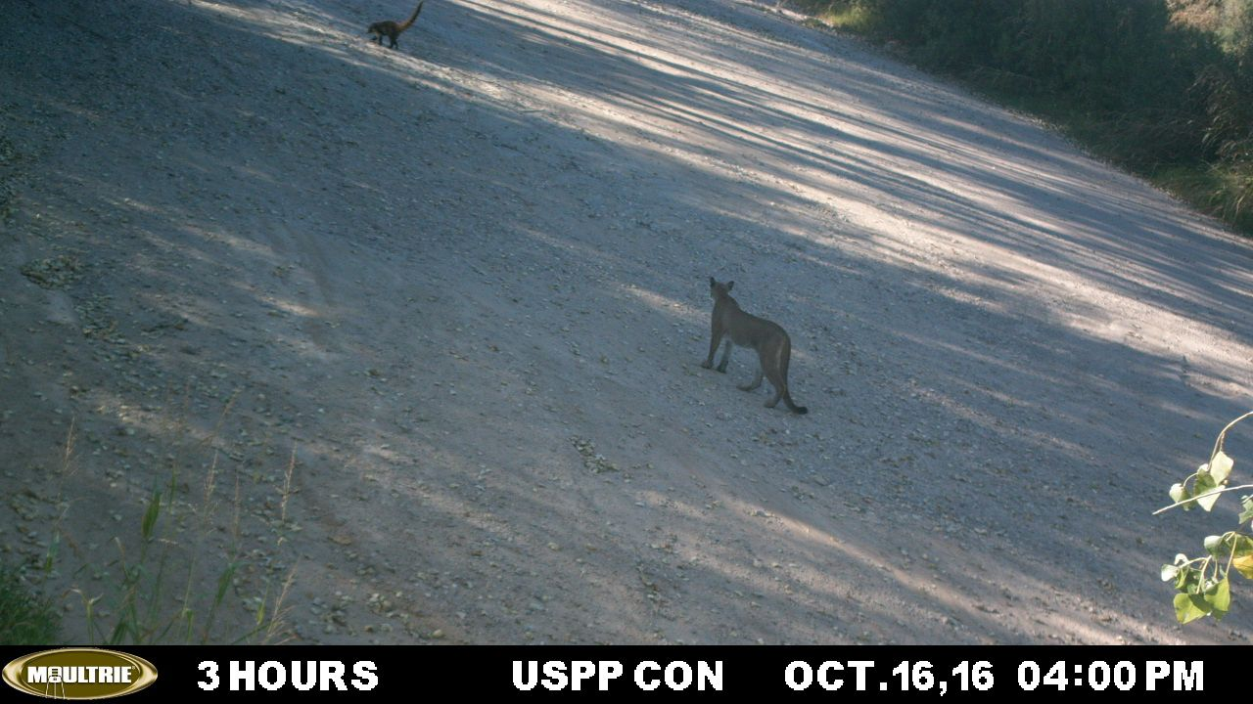
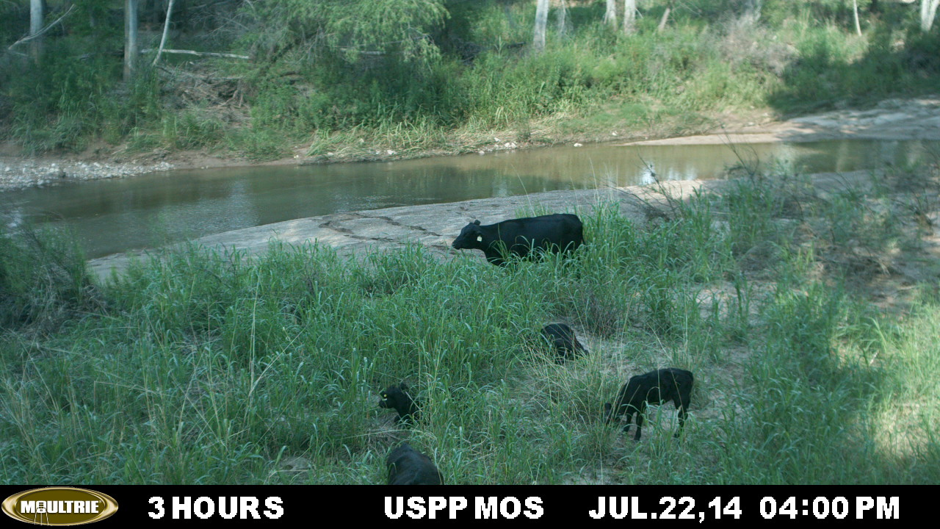
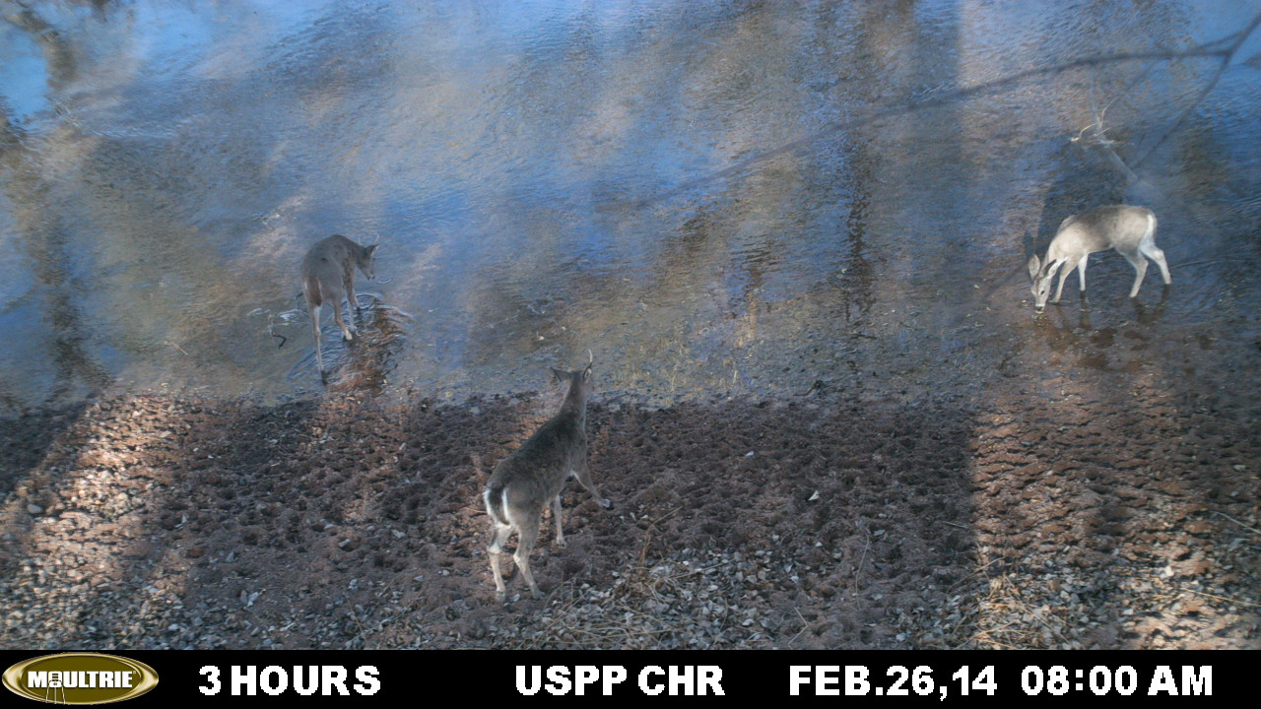
Summary
Net decrease in surface water presence since 2005
  Strongest decrease in monsoon season
  Monsoon season flow persistence trend decreasing more starting in 2018
  Monsoon season flow persistence variance increased since 2018
Higher vapor pressure deficit corresponds with dropping flow persistence
Reduction in precipitation has lagged effect on flow persistence

Slide 11
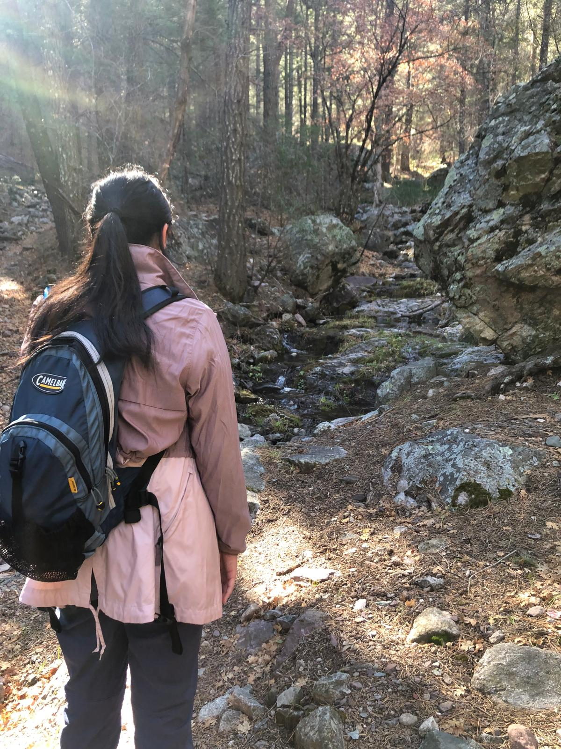
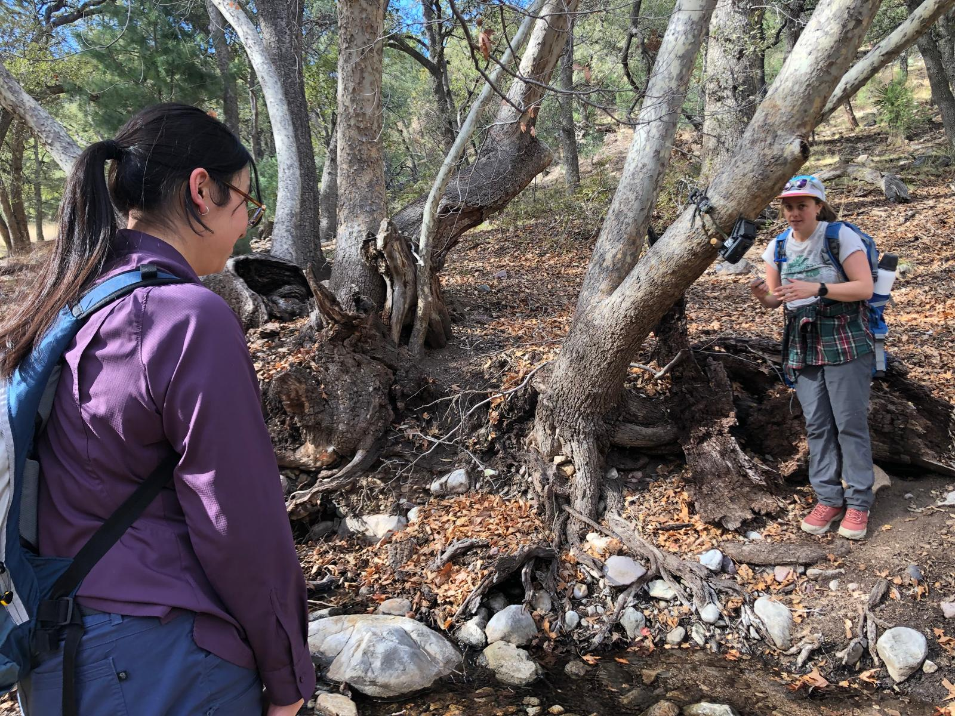
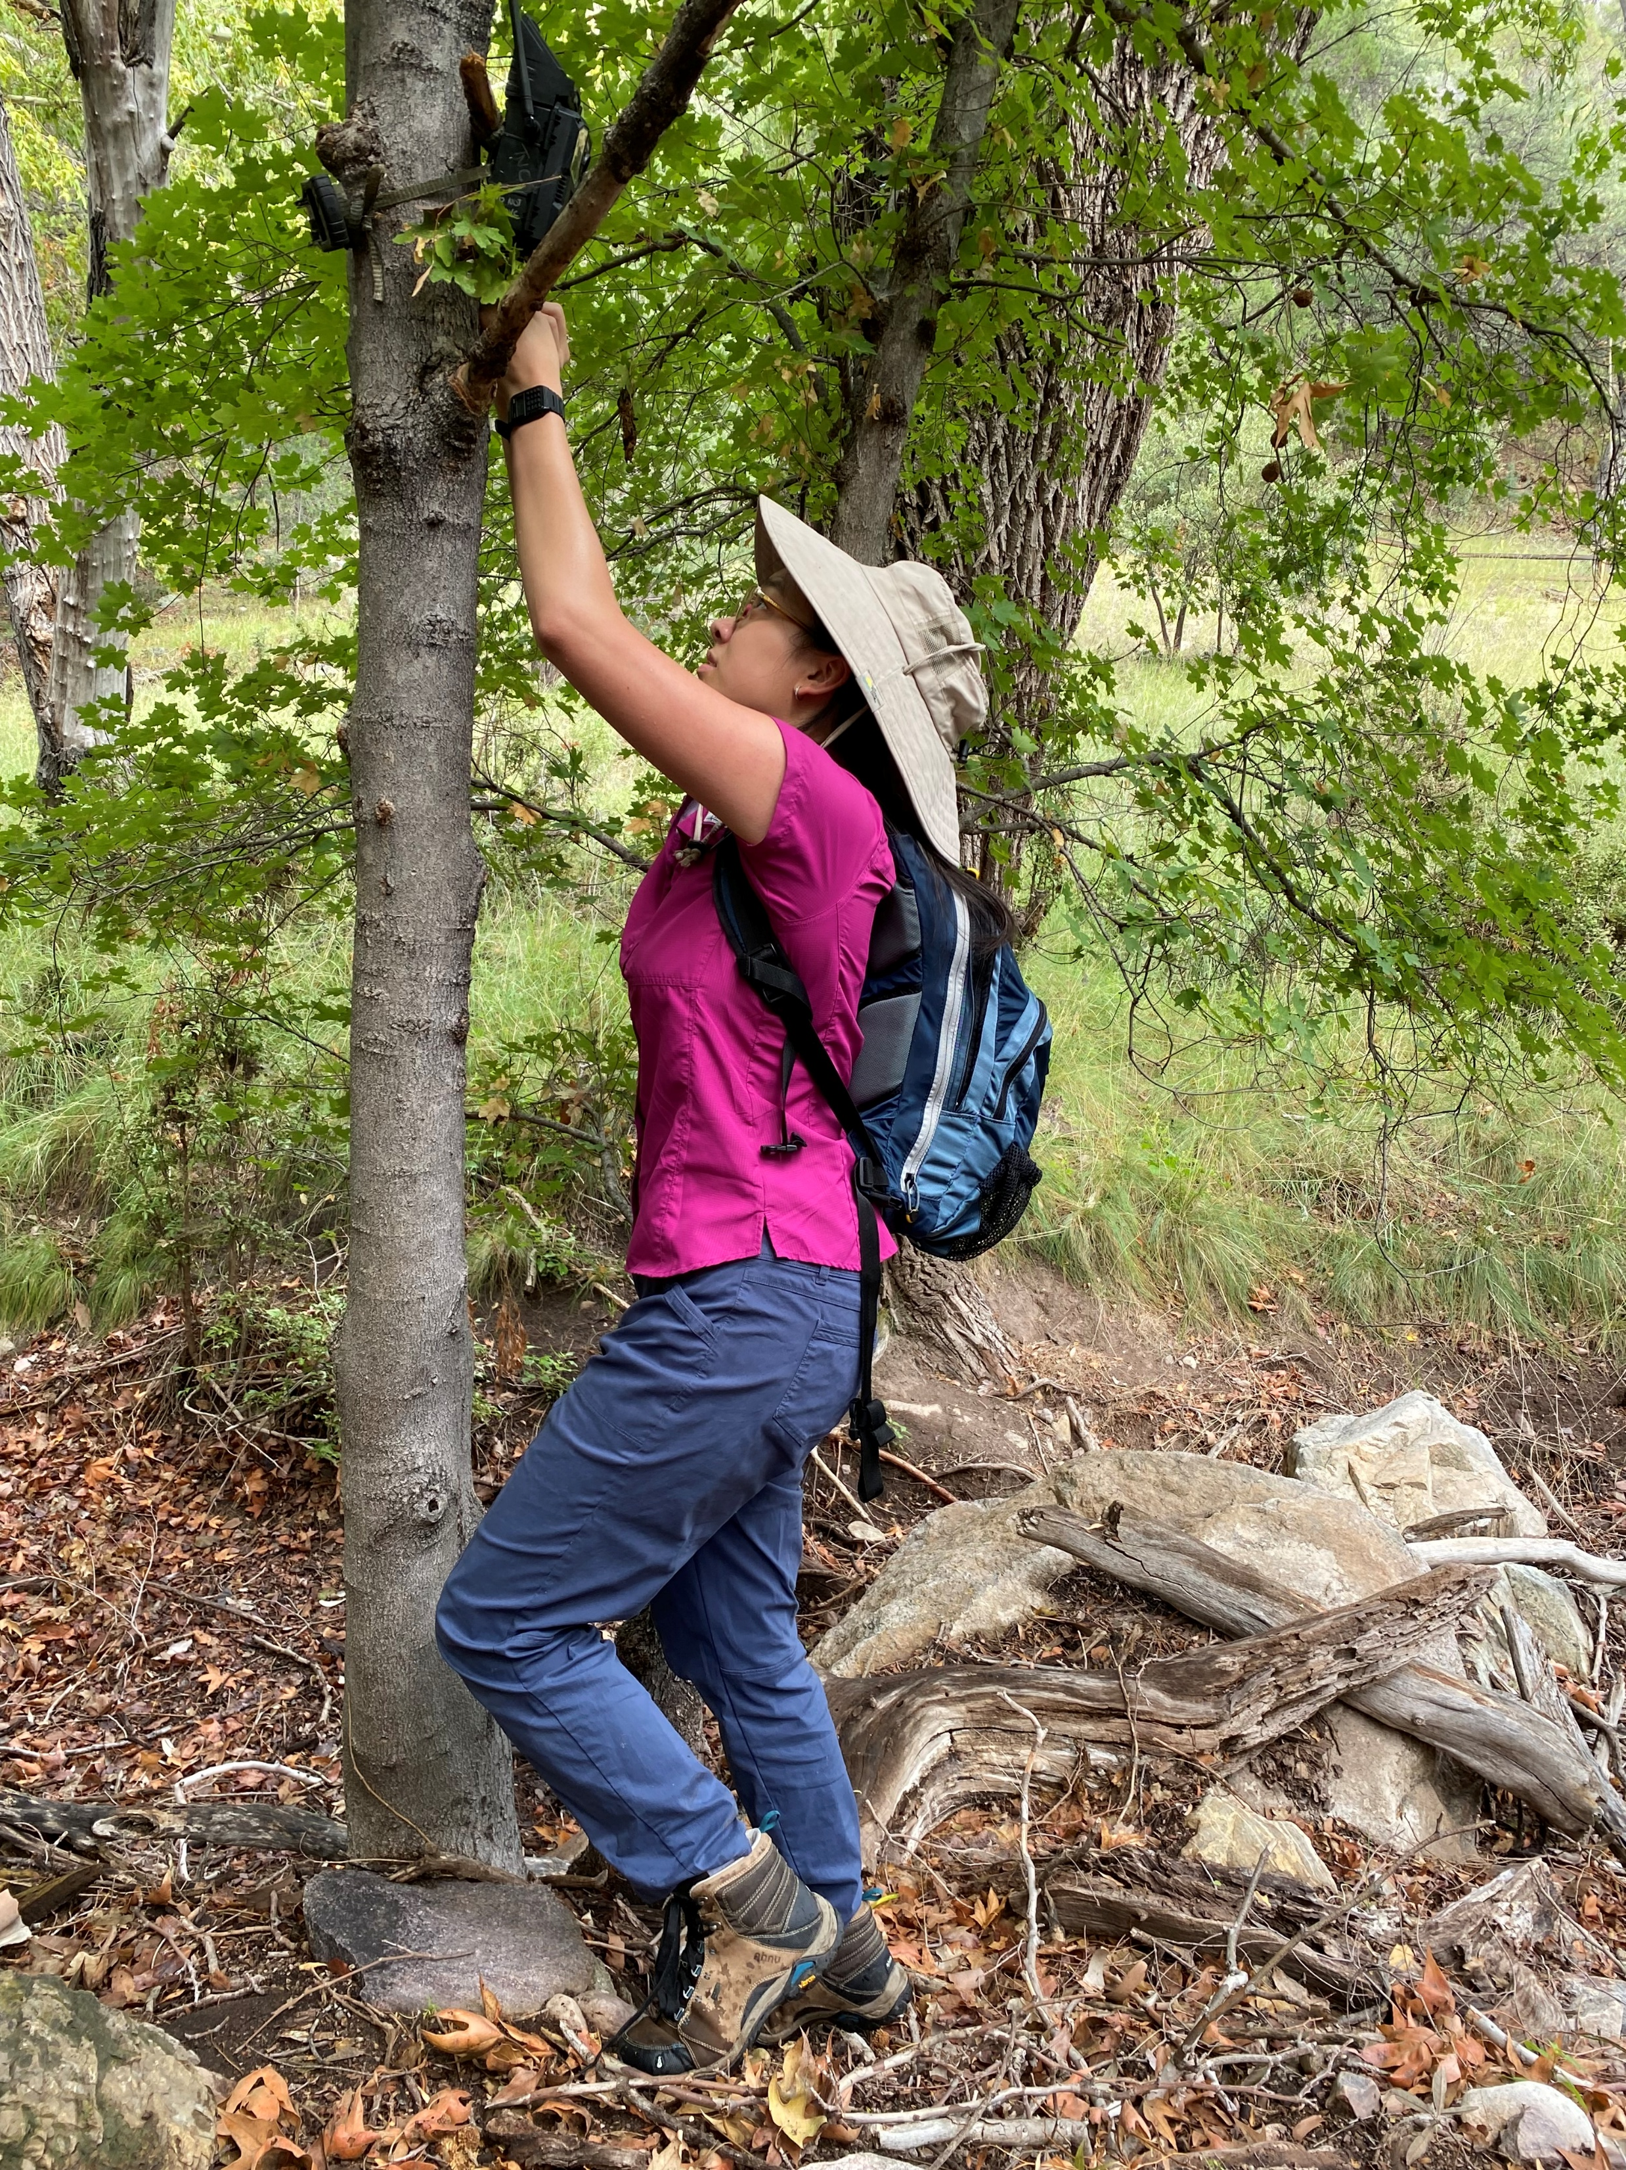
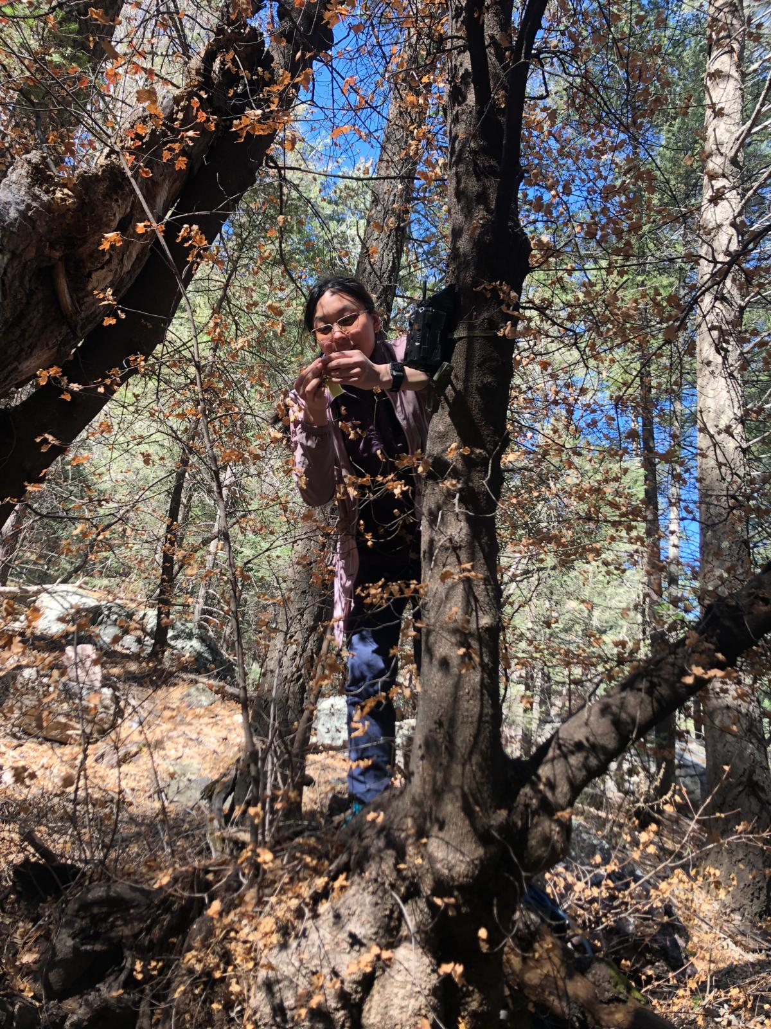
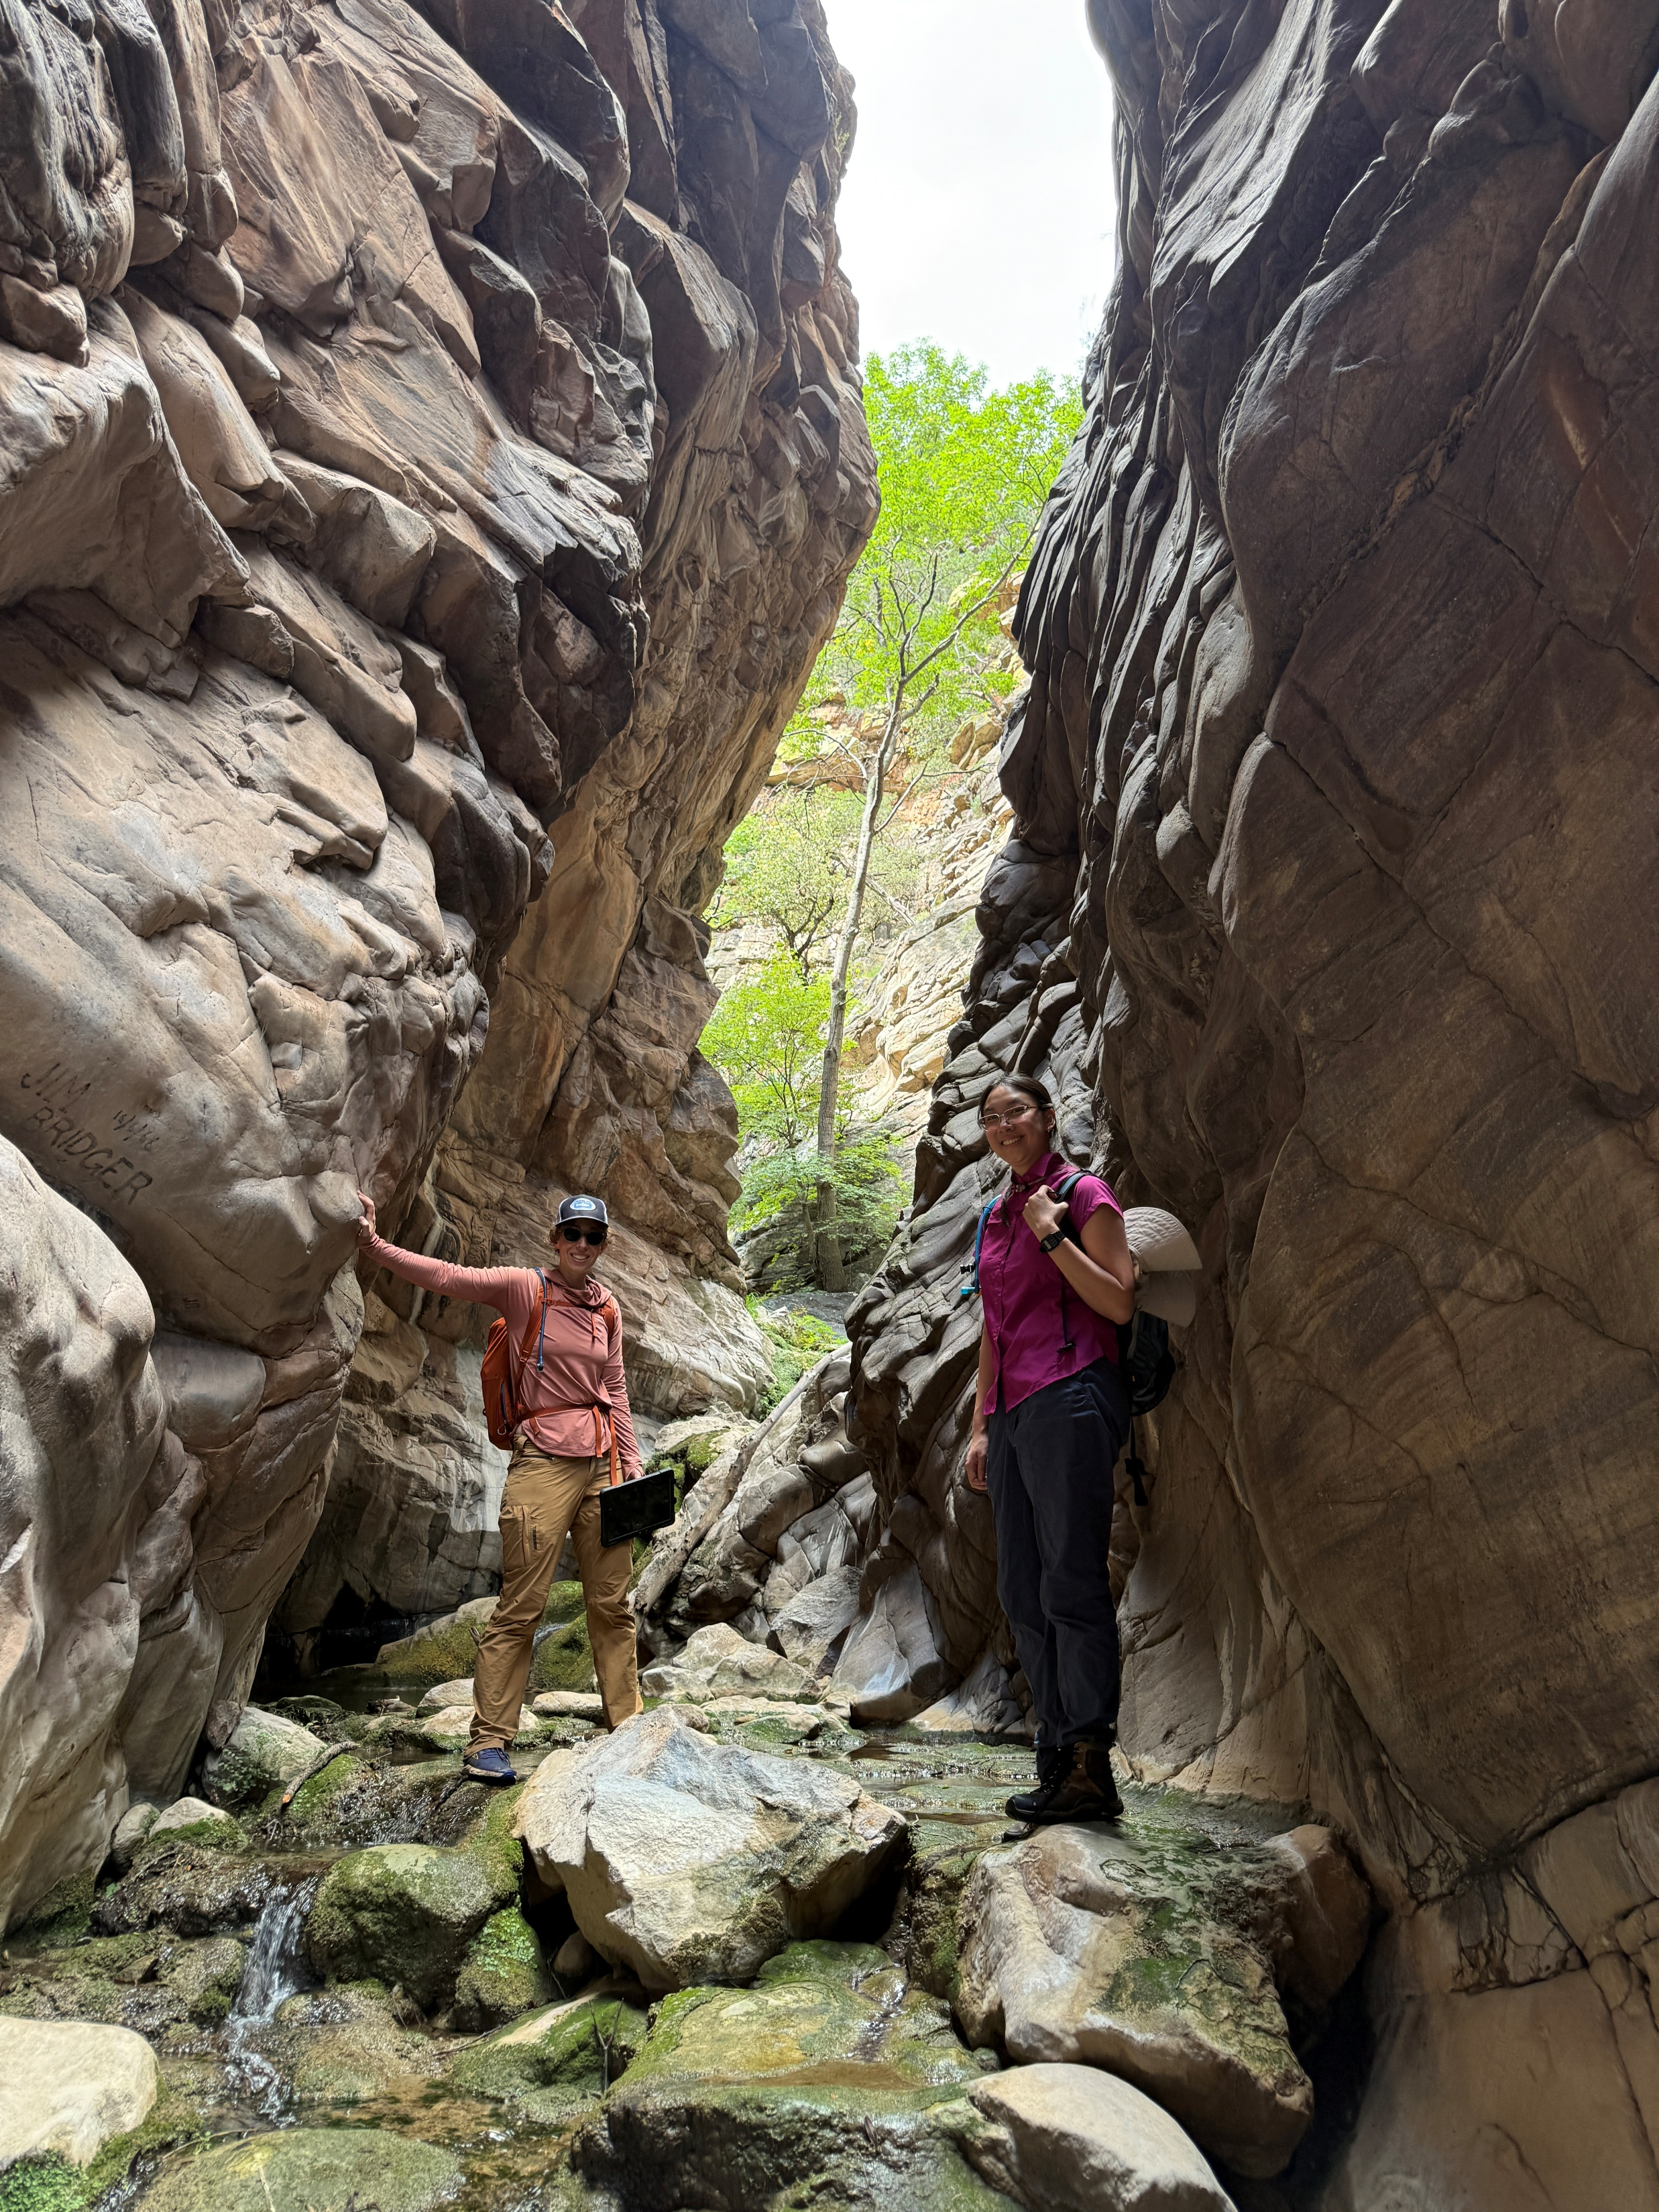
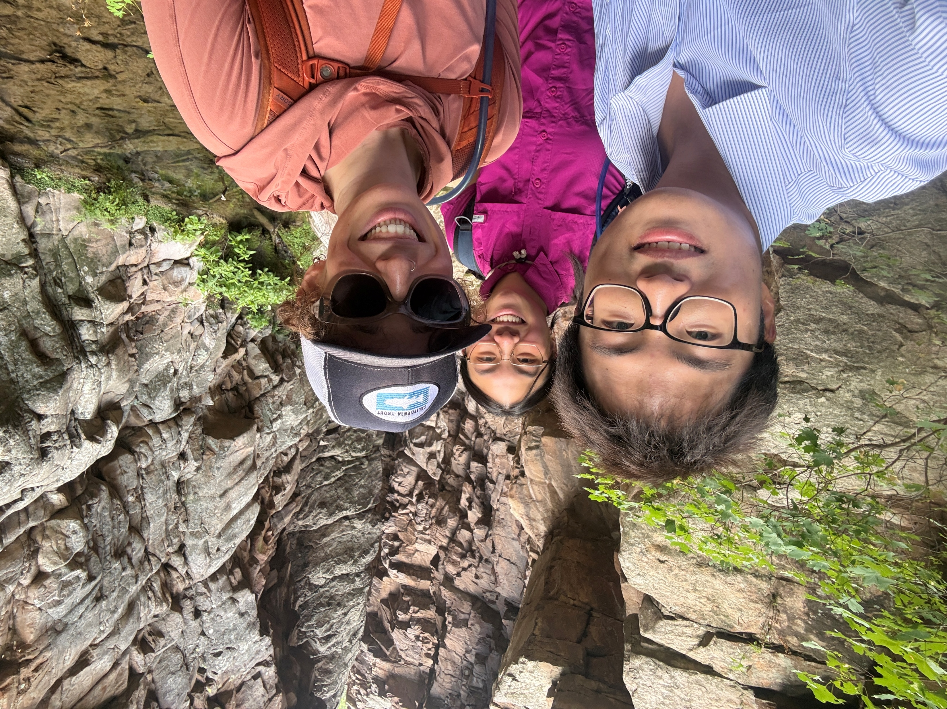
Thank you!
Acknowledgements:
Dana Lapides, Letao Li, Jessie Pearl, Shang Gao,
Southwest Watershed Research Center,
and Arizona Space Grant Consortium
Email: tiffanyle@arizona.edu

